Slide 1
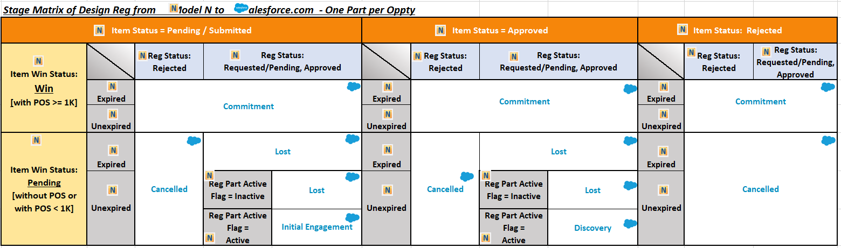
DATE Full Name
DR PD: Design Reg Production Date [MN]
SFDC ECD: SFDC Expected Closed Date
SFDC PD: SFDC Production Date
User PD: Production Date by TSE [SFDC]
User ECD: Expected Close Date by TSE [SFDC]
Once Oppty turn Cancelled/Lost, the Oppty Schedule including Expected Close Date and Production Date cannot be edited anymore.
When SFDC stage from non-Commitment to Commitment ; And Old ECD = New ECD ; And ECD is in the future, SFDC will set ECD to today.

